Slide 1
OSI model

Slide 2
The OSI (Open System Interconnection) model:
International standard organization (ISO) established a committee in 1977
to develop an architecture for systems communication.
Open System Interconnection (OSI) reference model is the result of this effort.
The OSI model describes how data flows from one computer, through a network
to another computer.
The OSI model consists of seven separate but related layers, each of which
defines a part of the process of moving information across a network.
This model allows any two different systems to communicate regardless of
their underlying architecture.

Slide 3
OSI model: 7 layers
7. Application
6. Presentation
5. Session
4. Transport
3. Network
2. Data Link
1. Physical

Slide 4
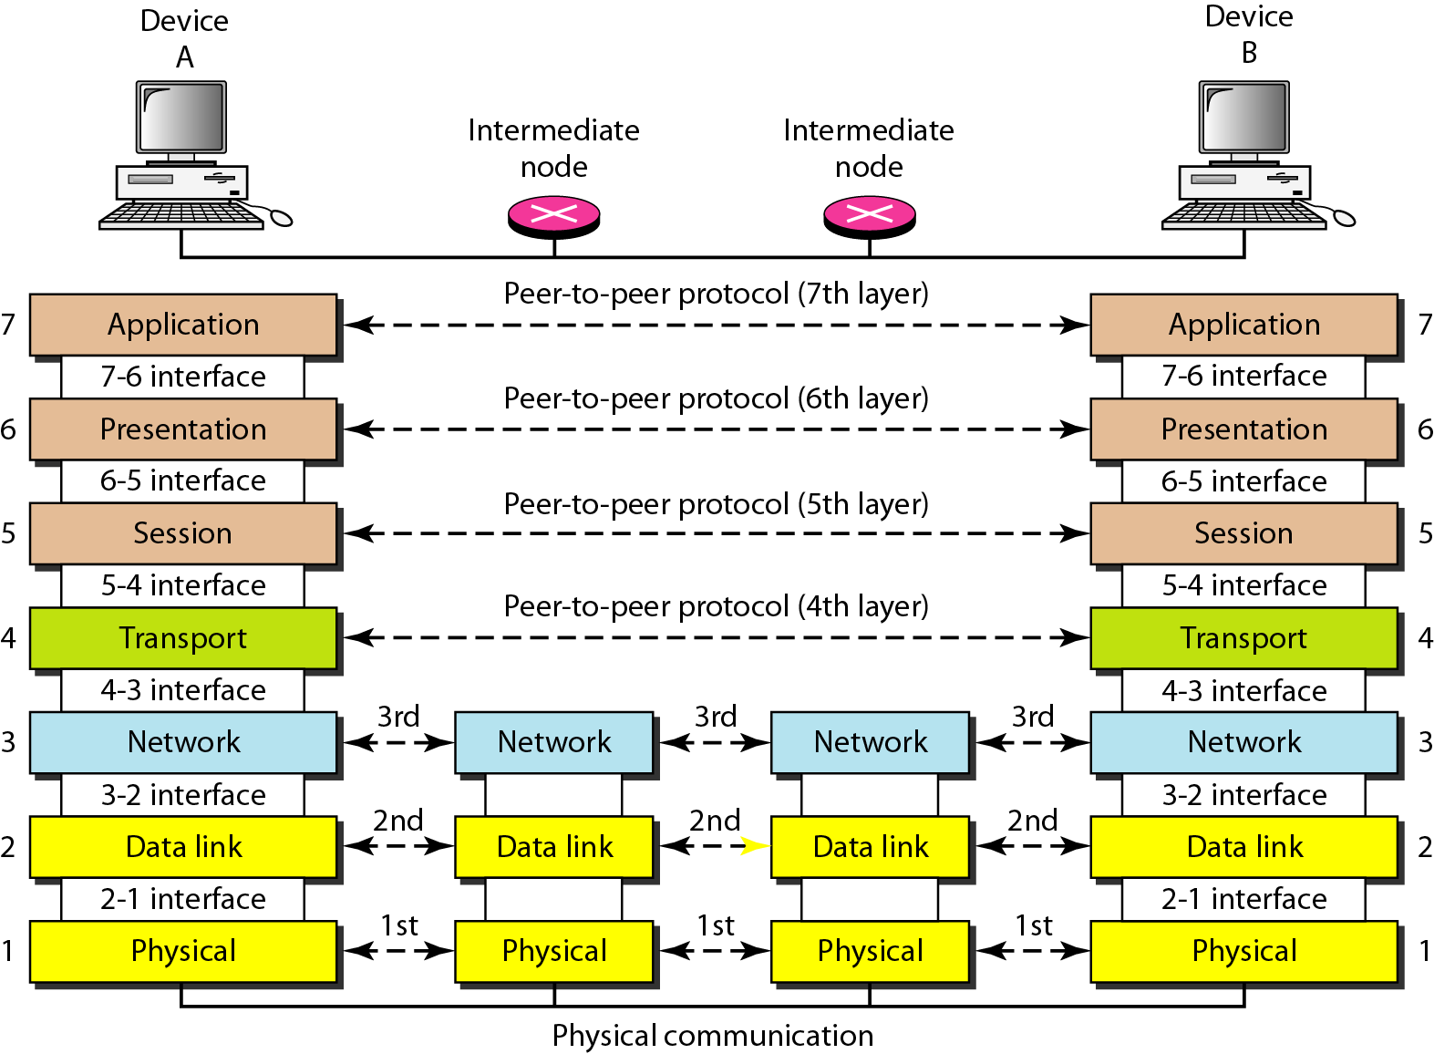
The interaction between layers in the OSI model

Slide 5
Layer 1: Physical Layer
The physical layer, the lowest layer of the OSI model, is concerned with
the transmission and reception of the unstructured raw bit stream over
a physical medium.
The physical layer is responsible for transmitting a bit stream over
a physical medium.
It encodes and decodes bits into groups of bits. It then transforms a stream
of bits into a signal.

Slide 6
Layer 2: Data Link Layer
The data link layer provides error-free transfer of data frames from one
node to another over the physical layer, allowing layers above it to assume
virtually error-free transmission over the link.
Handles special data frames (packets) between the Network layer and
the Physical layer.
At the receiving end, this layer packages raw data from the physical layer
into data frames for delivery to the Network layer.
At the sending end this layer handles conversion of data into raw formats
that can be handled by the Physical Layer.

Slide 7
Layer 3: Network Layer
The network layer controls the operation of the subnet, deciding which
physical path the data should take based on network conditions, priority
of service, and other factors.
Handles addressing messages for delivery, as well as translating logical
network addresses and names into their physical counterparts.
Responsible for deciding how to route transmissions between computers.
This layer also handles packet switching and network congestion control.

Slide 8
Layer 4: Transport Layer
The transport layer ensures that messages are delivered error-free,
in sequence and with no losses or duplications.
Responsible for source-to-destination delivery of the entire message.
Responsible for breaking the entire message into several packets and
delivery them to the network layer.
Responsible for ensuring that the whole message is transmitted.
If packets arrive out of order, they must be reorganized.

Slide 9
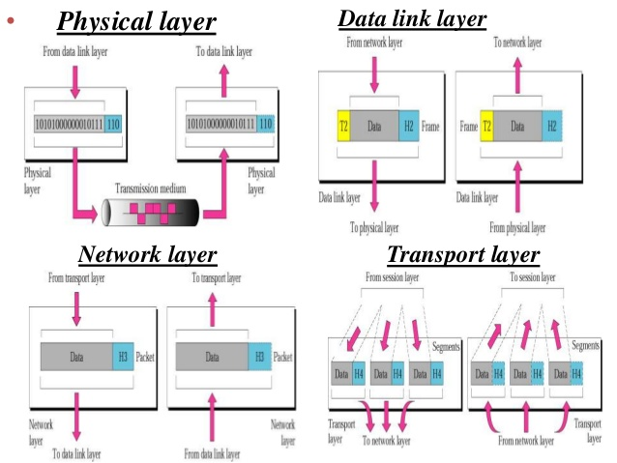
OSI layers diagram

Slide 10
Layer 5: Session Layer
The session layer allows session establishment between processes running
on different stations. It provides:
Session establishment, maintenance and termination: allows two
application processes on different machines to establish, use and terminate
a connection, called a session.
Session support: performs the functions that allow these processes to
communicate over the network, performing security, name recognition,
logging and etc.

Slide 11
Layer 6: Presentation Layer
The presentation layer formats the data to be presented to the application layer.
This layer may translate data from a format used by the application layer into
a common format at the sending station, then translate the common format
to a format known to the application layer at the receiving station.
The presentation layer provides:
character code translation: for example, ASCII to EBCDIC;
data conversion: bit order, CR-CR/LF, integer-floating point and etc;
data compression: reduces the number of bits that need to be transmitted
on the network;
- data encryption: encrypt data for security purposes.

Slide 12
Layer 7: Application Layer
The top layer of the OSI model
The application layer is responsible for providing services to the user.
Provides a set of interfaces for sending and receiving applications and to use
network services, such as: message handling and database query processing
The tasks of this level are file transfer, mail exchange and network management.

Slide 13
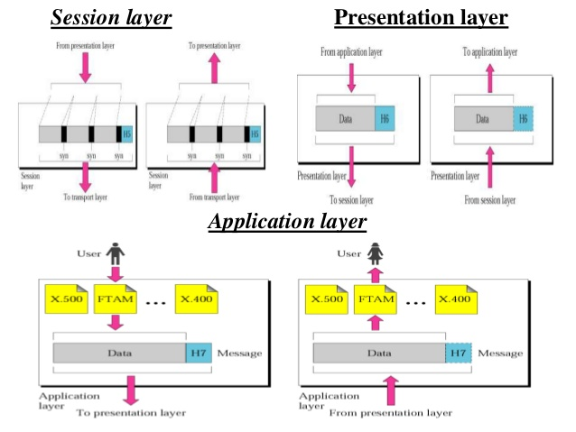
OSI layers diagram

Slide 14
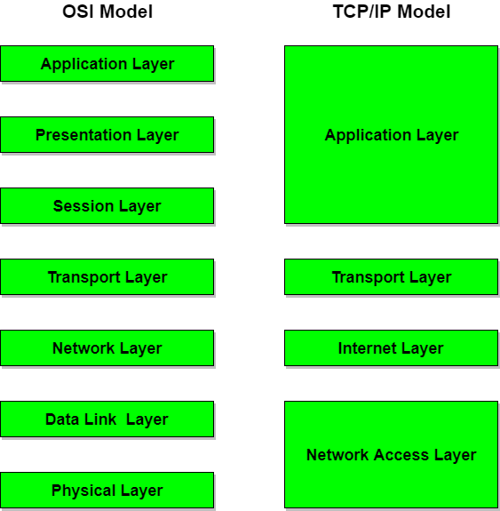
Comparison between OSI and TCP/IP model

Slide 15
Comparison between OSI and TCP/IP model
OSI (Open System Interconnection) | TCP/IP (Transmission Control Protocol / Internet Protocol)
1. OSI is a generic, protocol independent standard, acting as a communication gateway between the network and end user. | 1. TCP/IP model is based on standard protocols around which the Internet has developed. It is a communication protocol, which allows connection of hosts over a network.
2. In OSI model the transport layer guarantees the delivery of packets. | 2. In TCP/IP model the transport layer does not guarantees delivery of packets. Still the TCP/IP model is more reliable.
3. Follows vertical approach. | 3. Follows horizontal approach.
4. OSI model has a separate Presentation layer and Session layer. | 4. TCP/IP does not have a separate Presentation layer or Session layer.
5. OSI is a reference model around which the networks are built. Generally it is used as a guidance tool. | 5. TCP/IP model is, in a way implementation of the OSI model.
6. Network layer of OSI model provides both connection oriented and connectionless service. | 6. The Network layer in TCP/IP model provides connectionless service.
7. OSI model has a problem of fitting the protocols into the model. | 7. TCP/IP model does not fit any protocol
8. Protocols are hidden in OSI model and are easily replaced as the technology changes. | 8. In TCP/IP replacing protocol is not easy.
9. OSI model defines services, interfaces and protocols very clearly and makes clear distinction between them. It is protocol independent. | 9. In TCP/IP, services, interfaces and protocols are not clearly separated. It is also protocol dependent.

Slide 16
Thank you!

